Slide 1

Conservation
Petr Keil

Slide 2
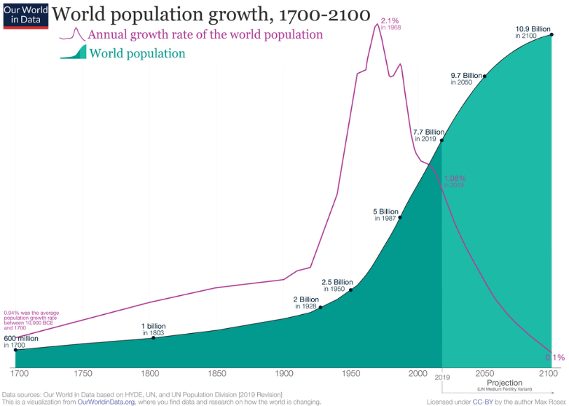
Human population trend and the Anthropocene (a.k.a. the “Age of Humans”)

Slide 3
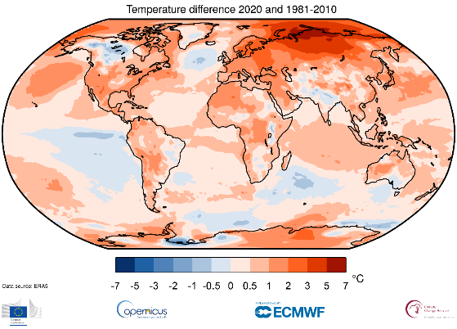
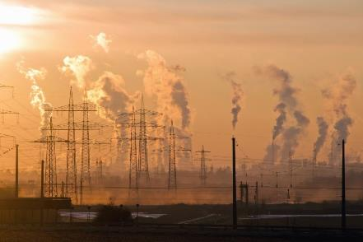
Humans are changing climate
Photo: Wikimedia Commons, Map: ERAS

Slide 4
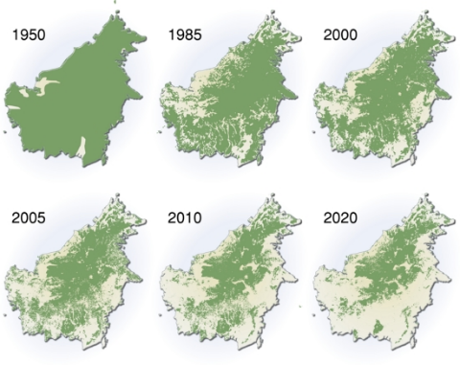
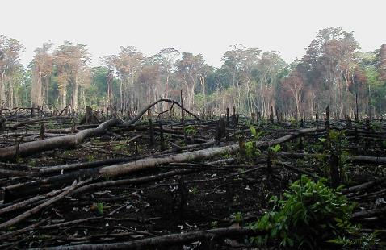
Humans dramatically affect land use
Deforestation of Borneo
Photo: Wikimedia Commons, Maps: UNEP

Slide 5
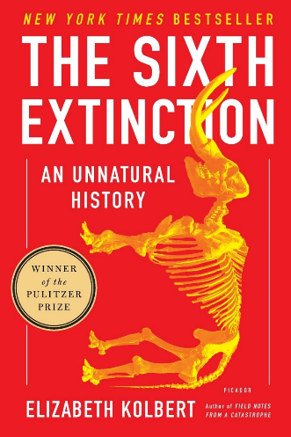
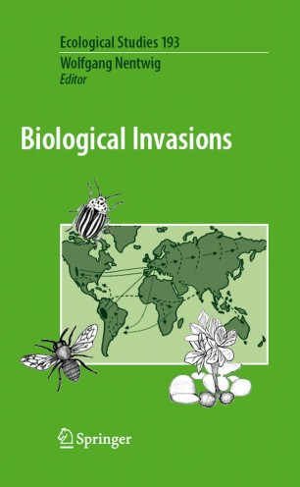
As a results, extinctions and invasions happen (but it’s also complex, recall last lecture)
IPBES (2019). Schiper et al. (2008) Science. Pereira et al. (2010) Science. Barnosky et al. (2012) Nature. Pimm et al. (2014) Science. Cowie et al. (2022) Biological Reviews.

Slide 6
Preventing undesirable biodiversity loss, extinctions, population declines, and range contractions

Slide 7
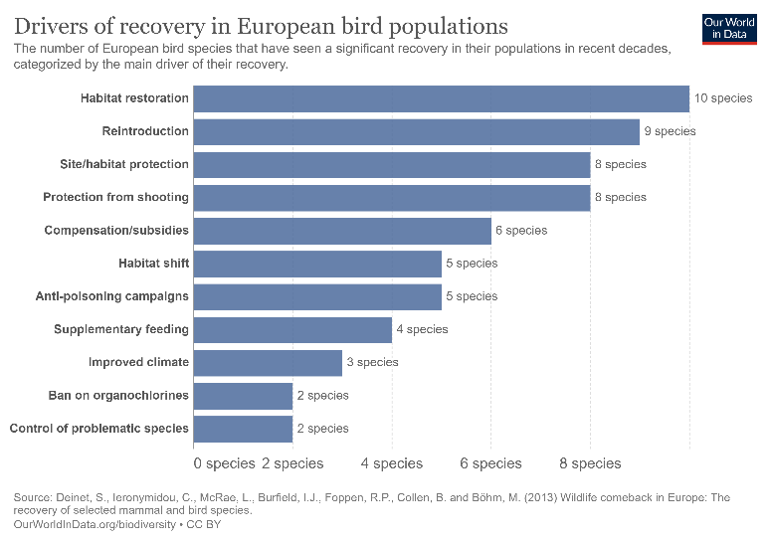
Many ways to do this
The main topics of this class

Slide 8
Option 1: Cessation of the pressure on specific taxa

Slide 9
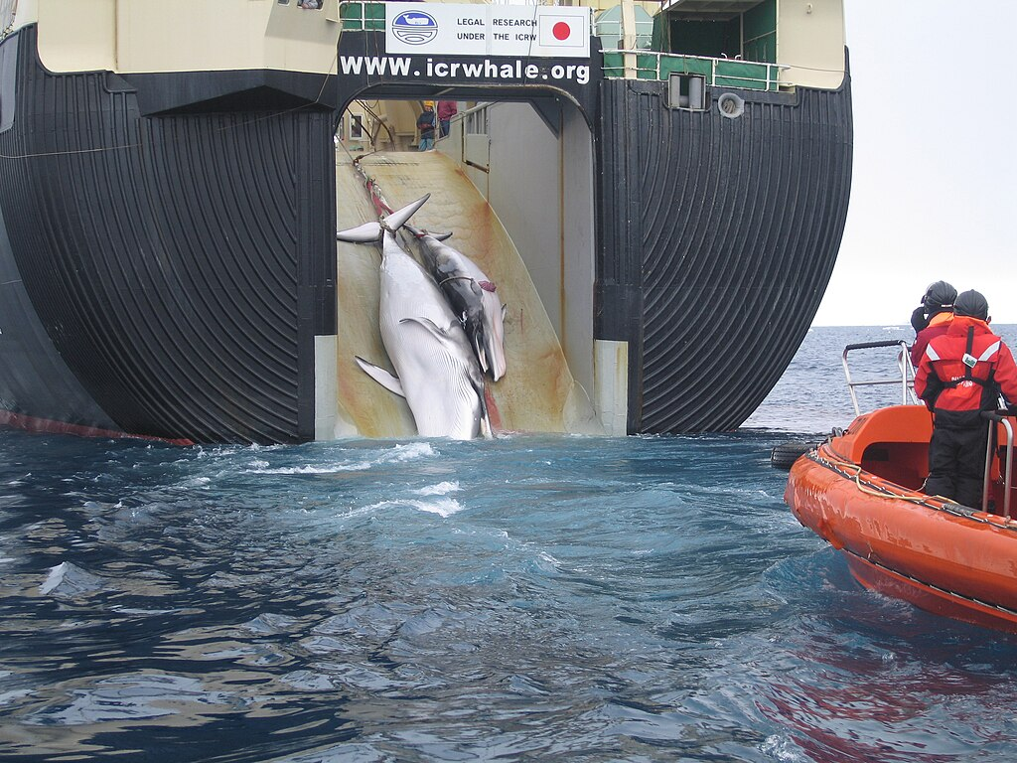
Whaling

Slide 10
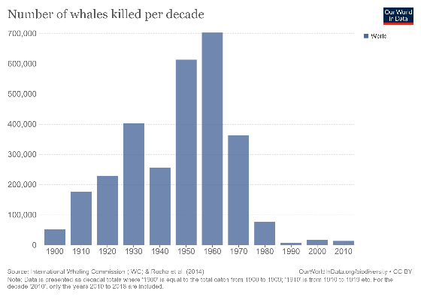
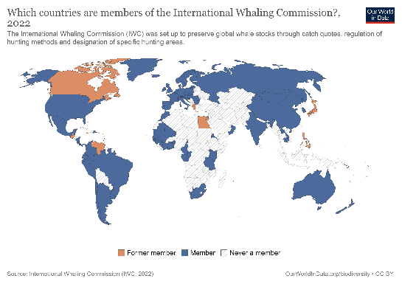
A story with a good ending for the whales
Although some whale species remain critically endangered, populations are still down, and recovery will take decades, the regulation of whale hunting has largely worked.

Slide 11
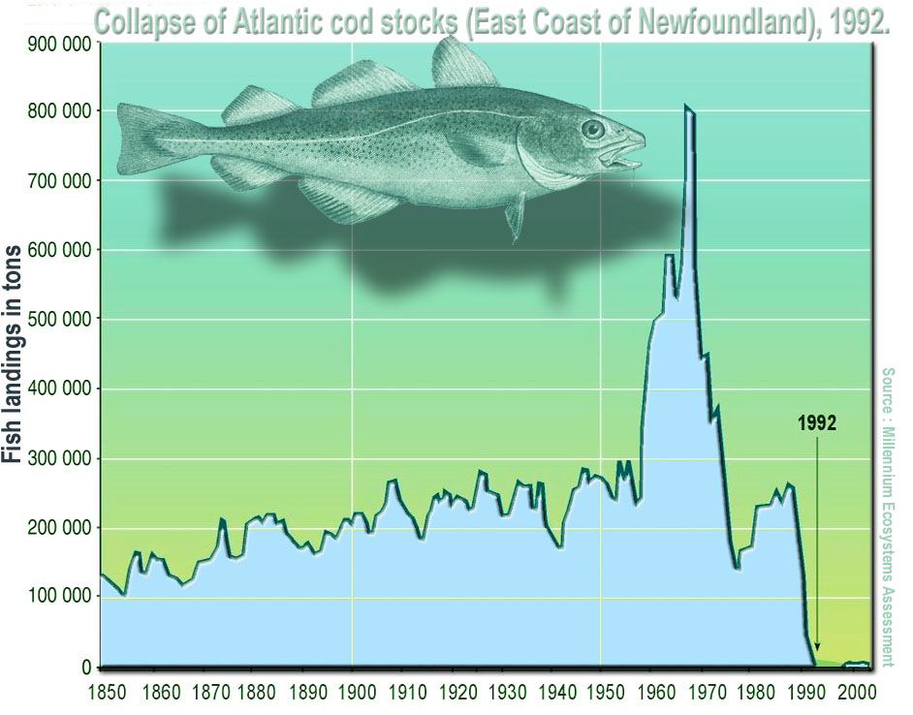
Collapse of the cod stocks – some signs of recovery
Rose & Sherylynn (2015) Cann. J. Fish. Aquat. Sci.

Slide 12
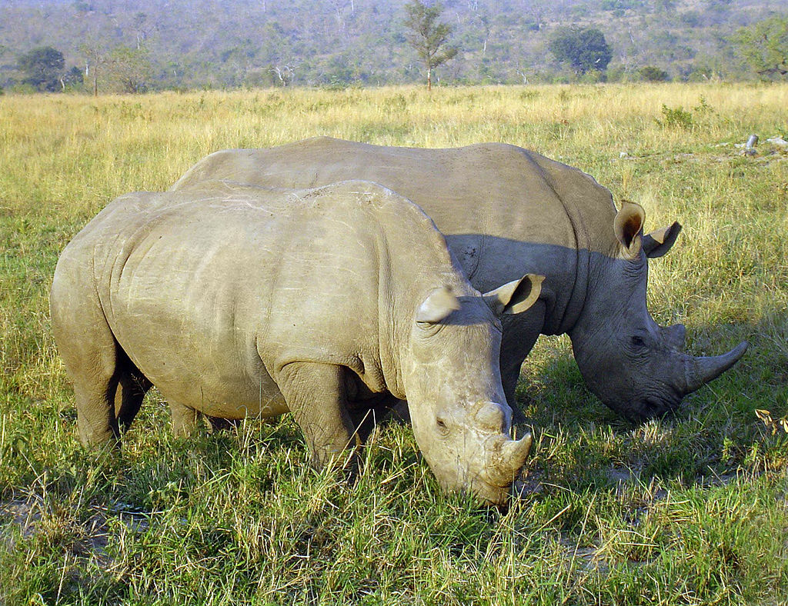
CITES
Convention on International Trade in Endangered Species of Wild Fauna and Flora, also known as the Washington Convention
Introduced 1975
The good
It regulates trade with vulnerable/protected species
Some populations have recovered as a response
The problems
Corruption and poor enforcing (particularly in developing countries in the tropics)
It can ramp up the price of the species
It complicates ex-situ conservation
It doesn’t protect the environment (habitat) of the species

Slide 13
Option 2: Protect or conserve the area or environment

Slide 14
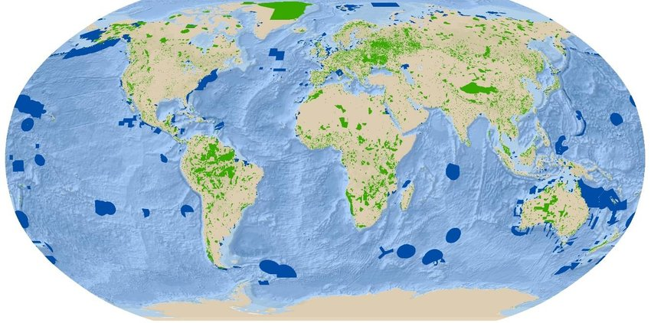
Global network of protected areas (in the WDPA)
273,259 polygons, 12,226 points (as of Dec 2022)
WDPA – The World Database of Protected Areas, www.protectedplanet.net

Slide 15
How much nature do we protect?
14,6% of land is designated a protected area
81% of key biodiversity areas are not completely covered by protected areas (IUCN)
Only 10% of Earth’s terrestrial protected areas are structurally connected (Ward et al. 2020 Nat. Comm.)
WDPA – The World Database of Protected Areas, www.protectedplanet.net

Slide 16
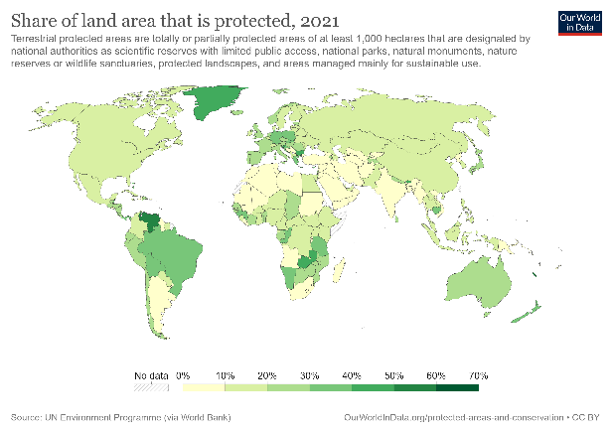
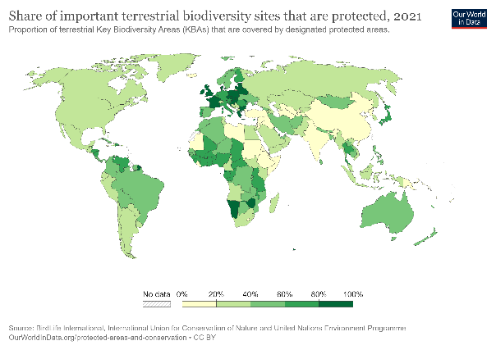
Do we protect enough?
WDPA – The World Database of Protected Areas, www.protectedplanet.net

Slide 17
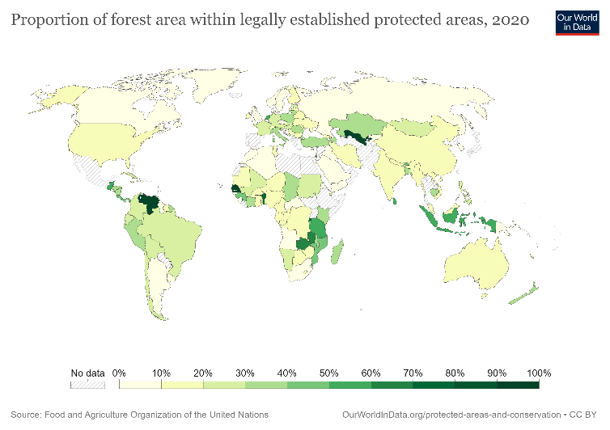
Do we protect enough of forest in the tropics?
WDPA – The World Database of Protected Areas, www.protectedplanet.net

Slide 18
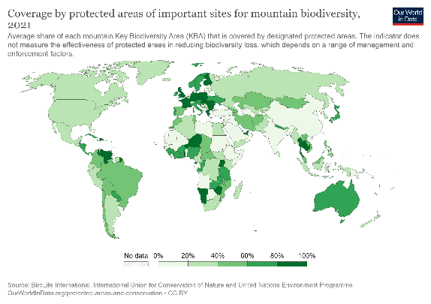
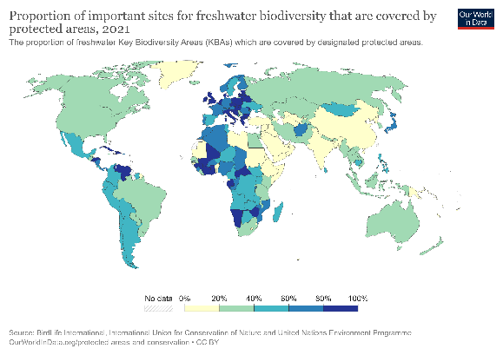
Do we protect enough mountain biodiversity and freshwater biodiversity?
WDPA – The World Database of Protected Areas, www.protectedplanet.net

Slide 19
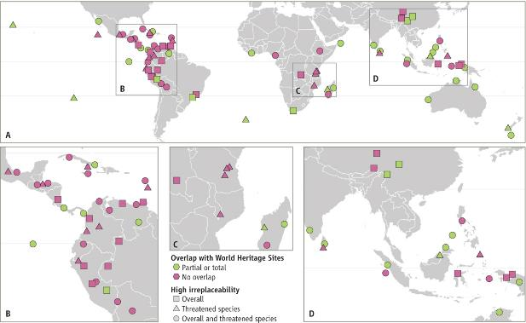
Where are the protected areas with most valuable species?
World’s most irreplaceable protected areas (based on amphibian, bird, and mammal diversity)
Le Saout et al. (2013) Science

Slide 20
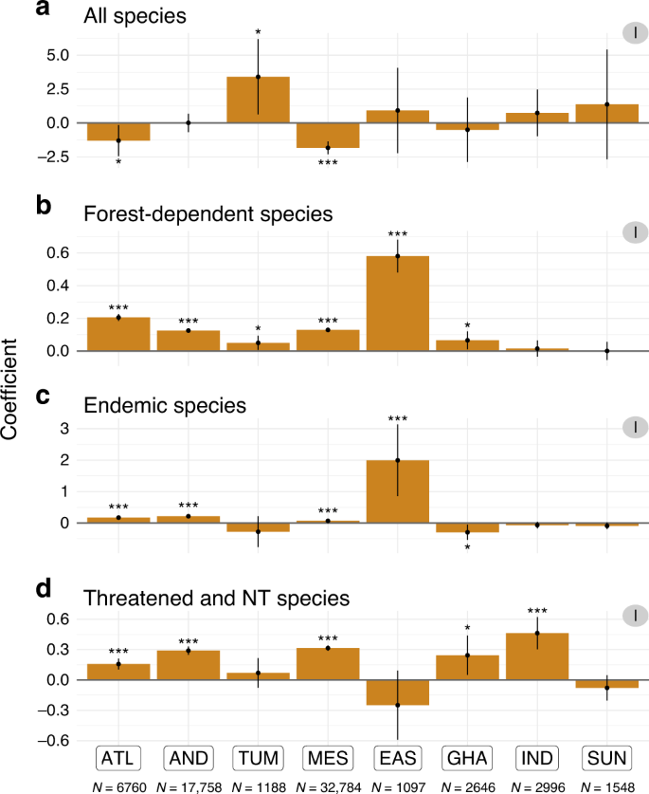
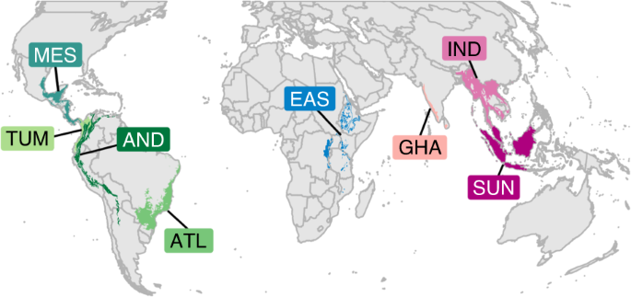
Do protected areas work? And what are we really protecting?
There is a positive effect on forest dependent, endemic, and threatened species. Not so much on species richness.
PAs prevent both forest loss and degradation.
Cazalis et al. 2020 Nature Communications – A study based on tens of thousands of eBird checklists

Slide 21
Conservation prioritization
Reserve selection, location, design, and management should depend on what is our priority, what we want to protect:
Biodiversity? And at which scale?
Endemism?
Beta diversity?
Specific emblematic or endangered species?
Specific habitat?
State of nature that is free from human influence?
Landscape characteristics? Geology? Historical human heritage?
Resources such as water?

Slide 22

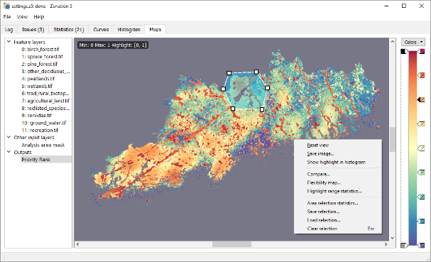
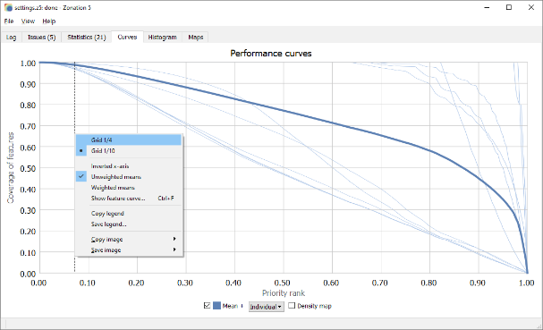
Conservation prioritization: Marxan, Zonation, and relatives
Iterative algorithms looking for solution to the minimum set problem. For example, how to protect 30% of range of each species as cheaply as possible?
Moilanen et al. (2011) Conservation Letters

Slide 23

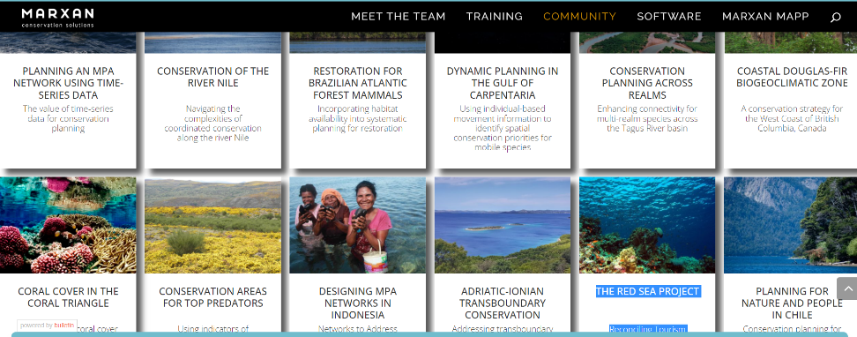
Conservation prioritization: Marxan, Zonation, and relatives
Iterative algorithms looking for solution to the minimum set problem. For example, how to protect 30% of range of each species as cheaply as possible?

Slide 24
Conservation prioritization – there are still huge gains to be made, potentially
We can protect more than 3x more of the global functional and phylogenetic diversity by just 5% increase in protected area, if the area is increased in a smart way.
Pollock et al. (2017) Nature

Slide 25
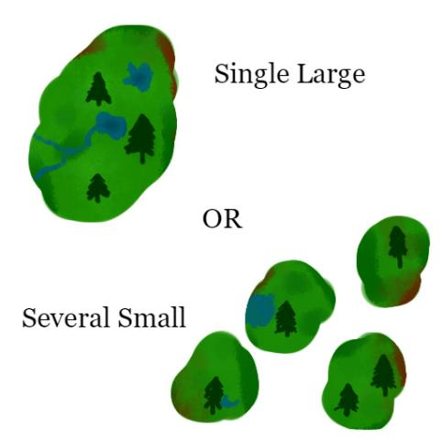
SLOSS – Single Large Or Several Small (protected areas)?
Peak of the debate during 1970’ and 1980’
MacArthur & Wilson’s Theory of Island Biogeography -> large islands have more species
Distance decay -> more fragments cover more environments, and cover larger extent, and have more species
Important to distinguish “fragmentation per se” vs habitat loss
Role of connectivity & dispersal, context, metapopulation processes
The debate has never been settled, but we have moved on

Slide 26
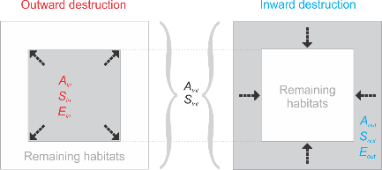
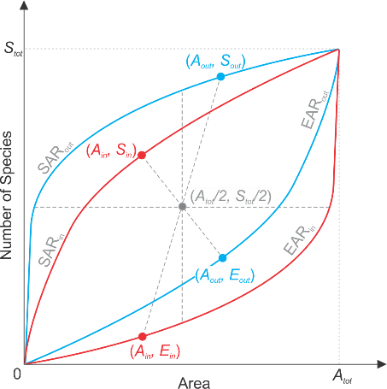
Core vs edge of the reserve – geometry plays a role here
Species-area relationships
We have shown some geometrical principles of how species are distributed within bounded domains
These have implications for reserve design: based on null expectations, species with smaller populations (more vulnerable) will be distributed around the reserve edges.
Number of species lost
with lost area
Keil et al. (2015) Nature Communications

Slide 27
Option 3: Active steps – management, rewilding, restoration

Slide 28
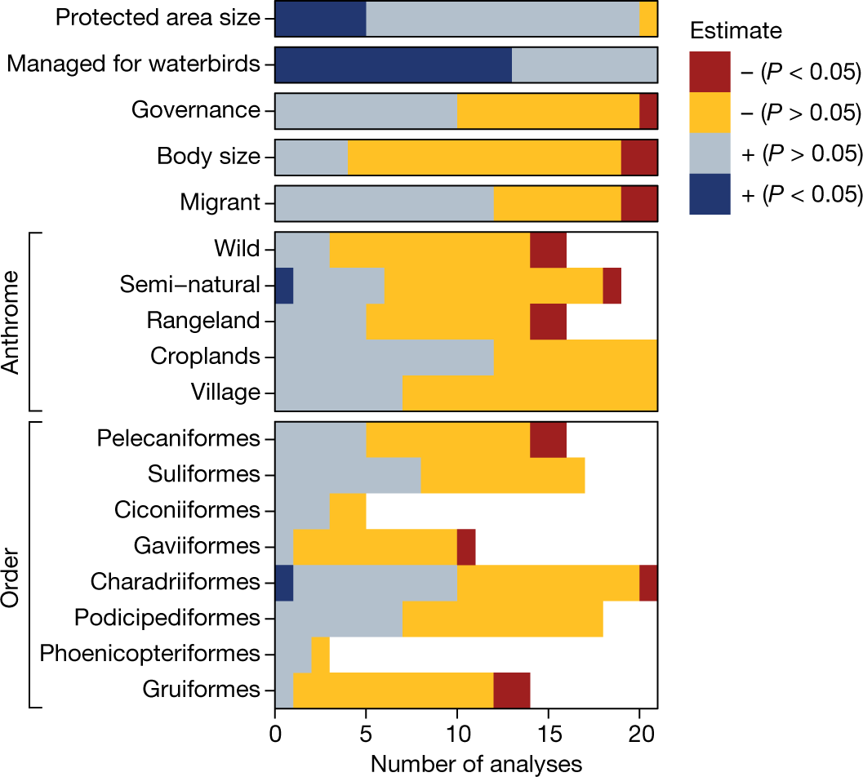
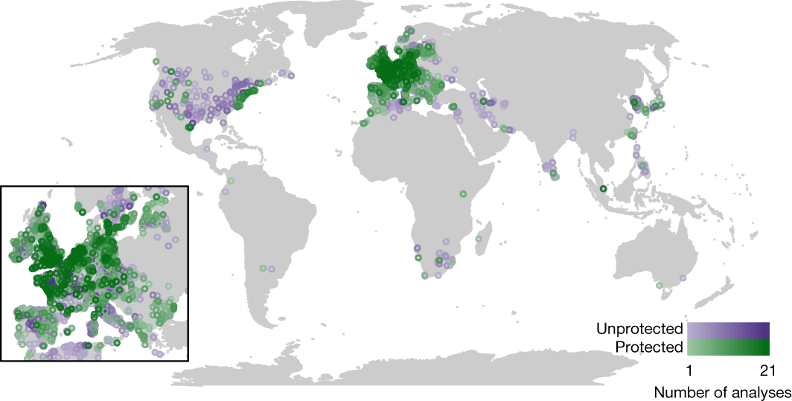
Is it enough to just conserve and protect? A story of waterbirds and wetlands
There is a positive effect on forest dependent, endemic, and threatened species. Not so much on species richness.
PAs prevent both forest loss and degradation.
Wauchope et al. 2022 Nature

Slide 29
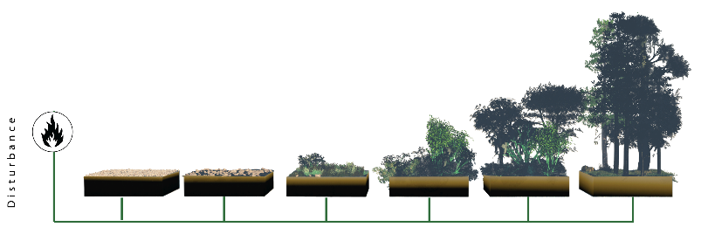
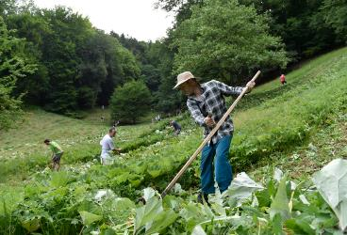
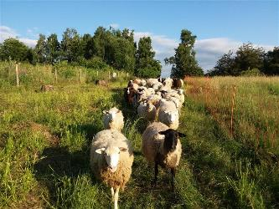
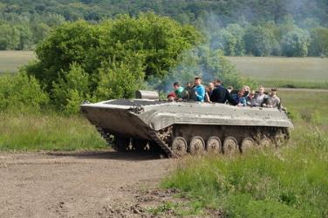
It’s not enough to just conserve: Active conservation management
Often, active management aims at keeping ecological succession at a certain stage
Succession
Photos: ČTK (Autor Dalibor Glück), Jana Nováková (Kraj Vysočina), Jan Wild (Beleco)

Slide 30
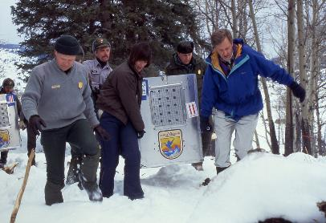
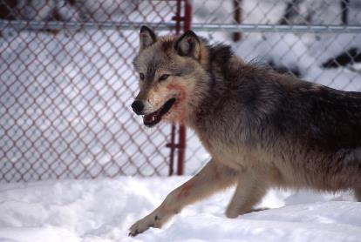
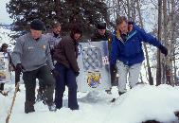
Rewilding, reintroductions
Grey Wold re-introductions in the US
300 wolwes in Wisconsin & Minnesota by 1960
Protected since 1974
> 5,500 wolves today in 48 states, thanks to human-assisted reintroductions
Photos: US National Park Service, Wikipedia

Slide 31
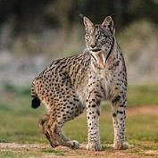
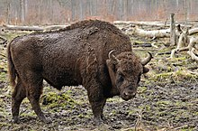
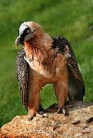
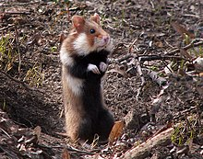
Rewilding, reintroductions
Iberian lynx in Portugal
European lynx in Switzerland, UK (proposed), and other parts of Europe
European bison in Poland & Belarus
Common hamster in Netherlands and Belgium
Bearded vulture in the Alps
Giant anteater, Giant otter, Jaguar, Guanaco, Red-and-green macaw – all in Argentina
Photos: US National Park Service, Wikipedia

Slide 32
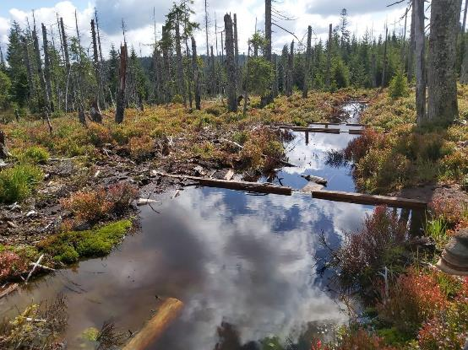
Active (human-made) habitat restoration, revitalization
Peatbog revialization at Šumava
Photos: Jitka Englová (Český Rozhlas)

Slide 33
Option #4: Spontaneous (passive) habitat restoration, revitalization
Frouz et al. (2009) Ochrana Přírody

Slide 34
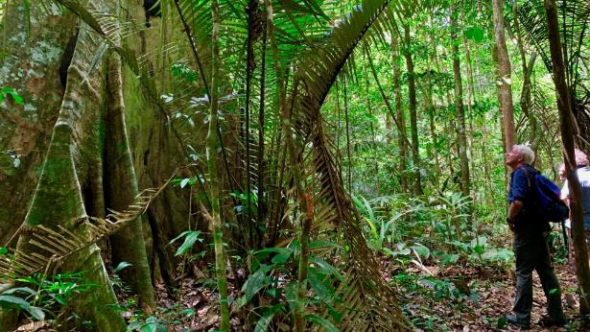
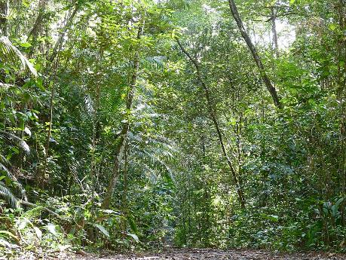
Secondary forests
Primary (left) and secondary (right) tropical rain forests in French Guiana
Photo: UNEP (left), Bernard Dupont (right)
Notes:
How are these environmental changes affecting biodiversity?
We often assume that the effect is negative, and we hear terms such as biodiversity crisis, or sixth mass extinction
For example, about 1% of known vertebrate species have gone extinct because of humans

Slide 35
Summary
We have multiple options for preventing extinctions, and promoting recovery of populations and ranges, e.g. nature reserves, cessation of pressures, reintroductions, restoration
Global network of protected areas is extensive, yet disconnected, and it misses a significant proportion of biodiversity and endemism. Even a minor extension of protected area can significantly increase effectiveness, if done right.
Related to protected areas: There was the SLOSS debate, it didn’t lead to clear results, but to the need to distinguish area loss vs. fragmentation per se.
Active reserve management is a must in many reserves, but it depends on what we want to protect.
Restoration is another big topic, and don’t forget about the option to restore passively, which can be the cheaper and more effective option.

Slide 36
Preventing undesirable introductions

Slide 37
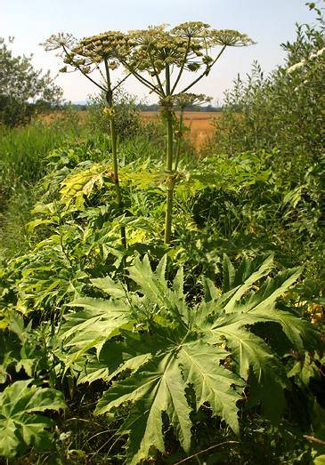
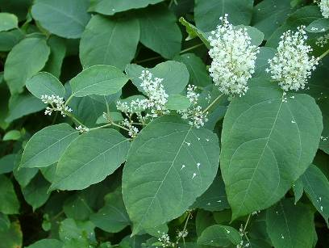
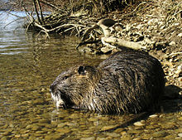
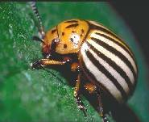
Invasive species

Slide 38
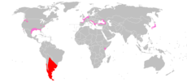
Invasive species

Slide 39
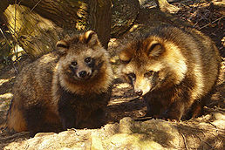



Invasive species

Slide 40




Invasive species

Slide 41







Invasive species

Slide 42

The invasion curve
Boudouresque et al. (2005)

Slide 43
Thank you. Questions?

